Slide 1
Seaborn Plots in Python
Overview + Swarm & Strip Plots

Slide 2
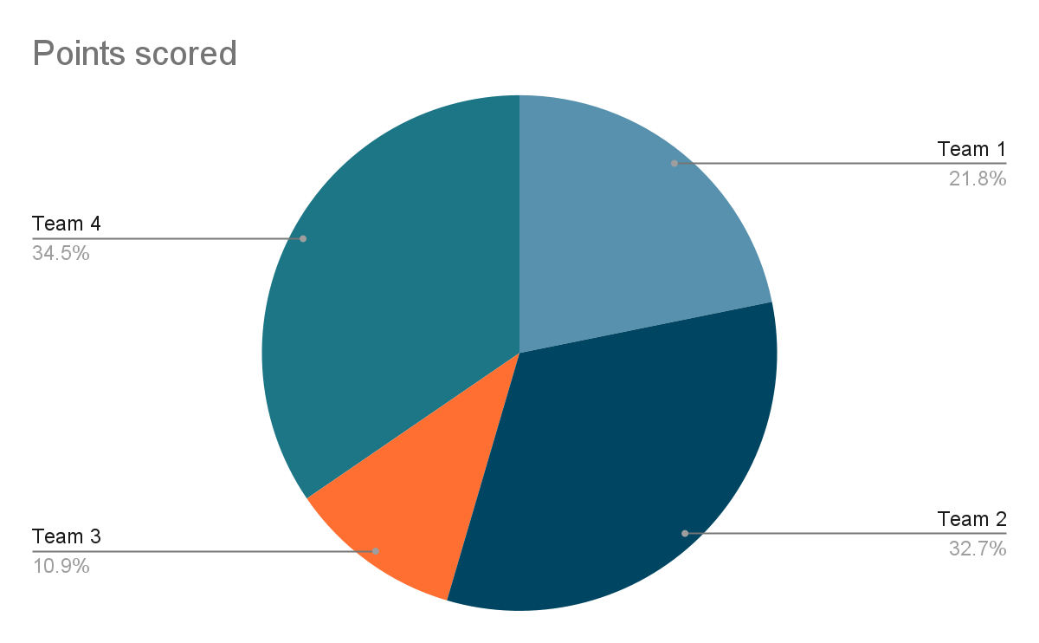
What is a Chart ?
Visualizing data in a simple and meaningful way
A Chart is a visual representation of data
Converts numbers/text into shapes or colors
Easy to understand at a glance
Helps compare values and see trends

Slide 3
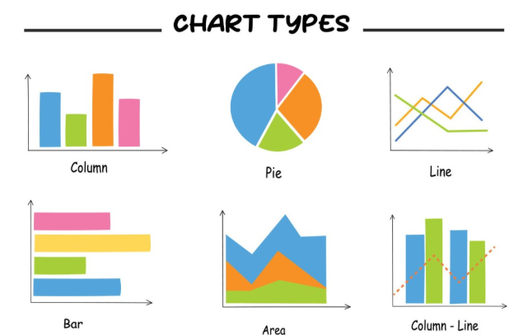
Seaborn Plots in Python
Focus on Strip and Swarm Plots
Seaborn is built on Matplotlib
Provides beautiful default styles
Makes statistical visualizations simple and powerful

Slide 4
Overview of Seaborn Plot Types
Relational Plots scatterplot, line plot Show relationships between variables | Categorical Plots barplot, boxplot, stripplot, swarmplot Compare categorical groups of data
Distribution Plots histplot, kdeplot, rugplot Shows the distribution /spread of data | Matrix/Multivariate Plots heatmap, pairplot, jointplot Explore correlations and relationships across multi variables

Slide 5
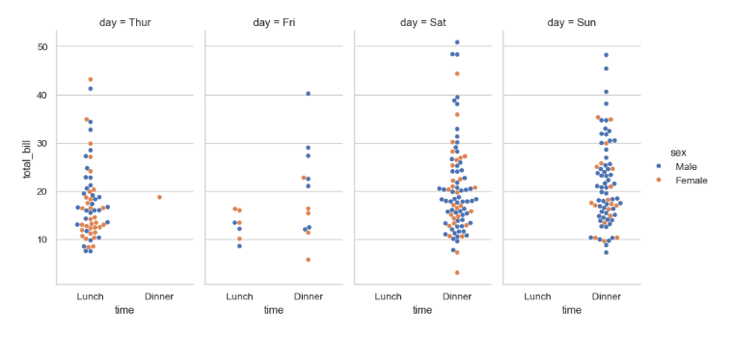
Strip Plot
What is it? Scatter plot where data points are adjusted to avoid overlap, forming a “swarm-like” pattern.
When to use? Used to show all raw data points clearly without overlapping — good for small/medium datasets.
Axes: X-axis = categories, Y-axis = values.
How to read: Each dot = one observation; the swarm arrangement shows distribution while avoiding overlap.
Example: Bills by day → X = Day, Y = Total Bill (dots spread to avoid overlap).

Slide 6
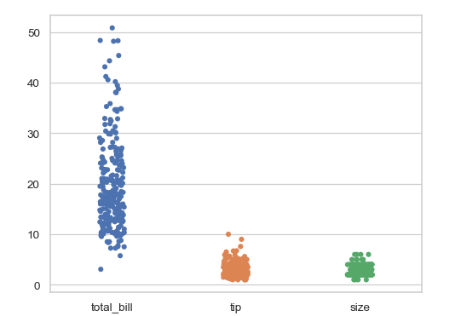
Swarm Plot
What is it? Scatter plot showing each data point as a dot across categories.
When to use? Show all raw data points in small/medium datasets.
Axes: X = categories, Y = values.
How to read: Each dot = one observation; Vertical spread = distribution.
Example: Bills by day → X = Day, Y = Total Bill.

Slide 7
Thank you

